Slide 1

Name: TAIWO OSENI
Project: Airbnb Tableau visualization

Slide 2

TABLE OF CONTENTS
Process Involved in Analyzing the Dataset
Five assessments in the dataset
Airbnb assessment dashboard
Map - Geographical summary
Further analysis of dataset
Further analysis of dataset dashboard
Limitation and observation of analysis

Slide 3
Process Involved In Analyzing the Dataset
Connect the data
Study and analysis of data set
Visualization of five Airbnb trends and review
Geographical Map Summary
Further Analysis Questions on dataset
Create a dashboard

Slide 4
Five assessment in the dataset
Price Distribution by Neighbourhood: Histogram
To effectively analyze and compare the distribution of prices across different neighbourhoods, highlighting areas with more variability in prices as well as those with more uniform pricing.
Room Type Popularity and Average Price: Side by Side Bar chart
To understand which room types are most common and how their prices compare.
Trends in New Prices over time: Line Graph
To analyze how prices have trended since hosts have started listing on Airbnb
Correlation Between Number of Beds and Price: Scatter Plot
To reveal if there's a trend where more beds lead to higher prices
Review Scores vs. Price: Scatter Plot
To examine if higher-rated listings tend to be more expensive

Slide 5
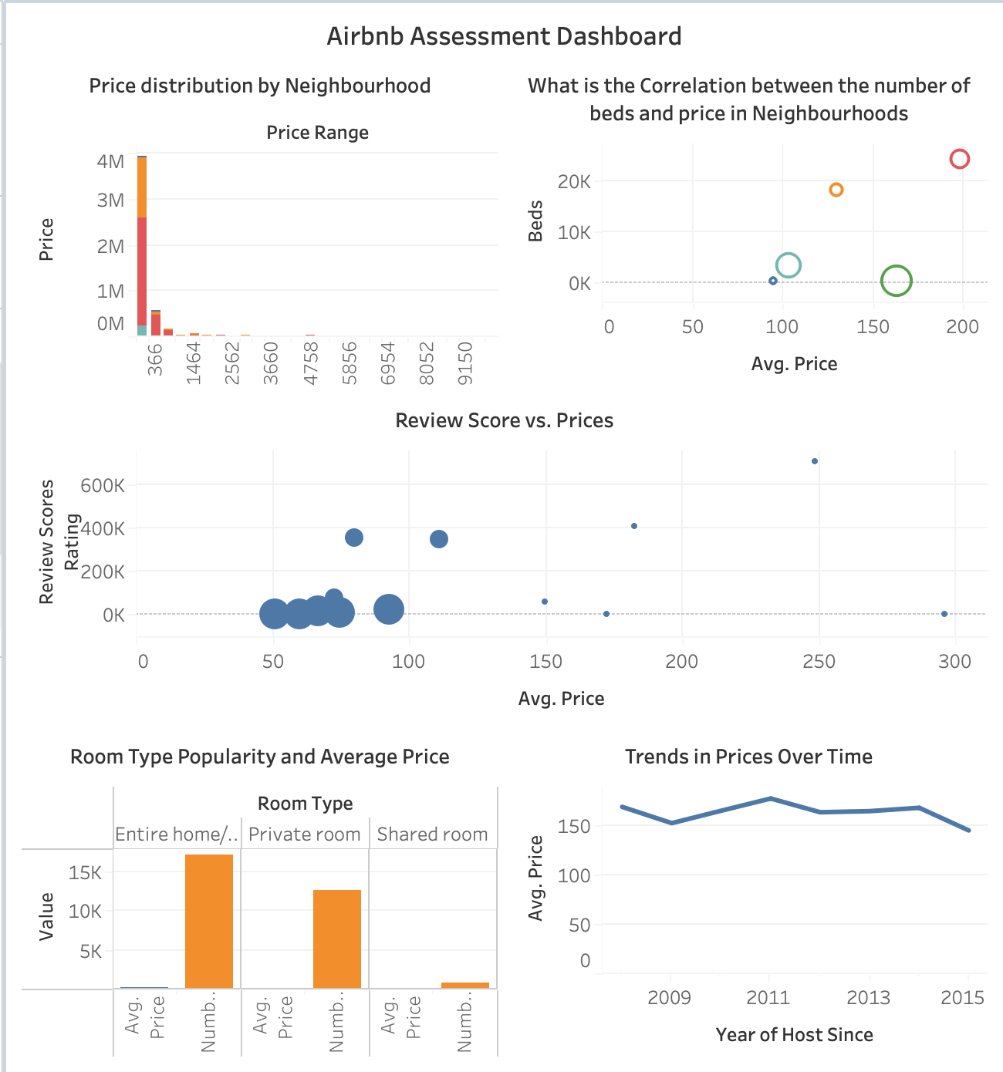

Slide 6
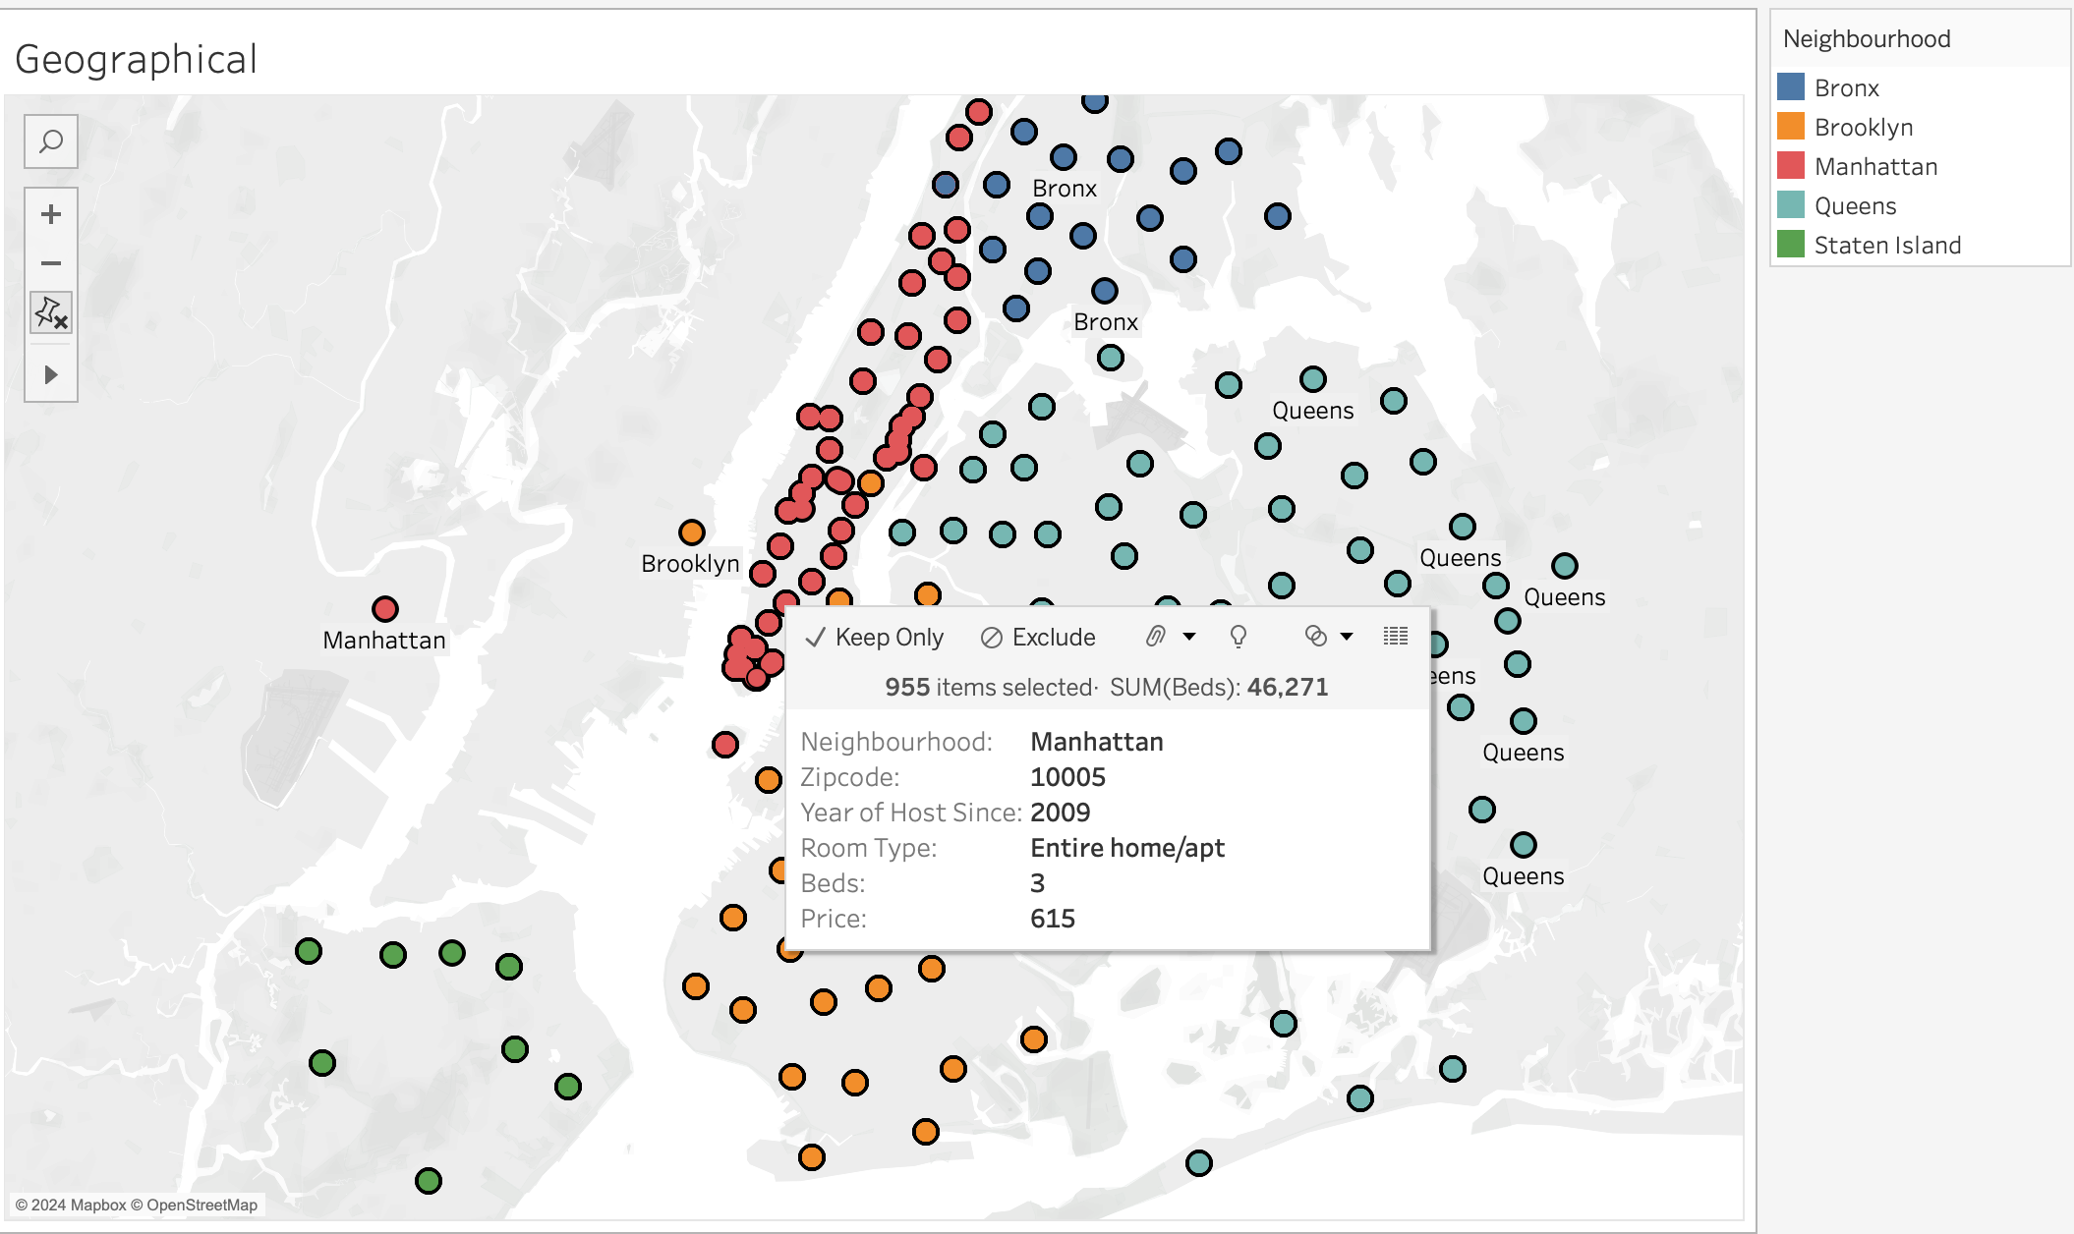

Slide 7
Further analysis of dataset
Which neighbourhoods have the highest and lowest average prices?
To see how different room types affect average prices in neighbourhoods and analyze how this impacts pricing in different areas.
Results Highest Manhantan Lowest: Bronx
Is there a seasonality in the Airbnb prices in New York City?
To compare different years and see how seasonality trends evolve and explore if seasonality effects vary by location.
Results: Mahanttan ⬆️ in 2008-2014 ⬇️in 2015
What is the average number of reviews per room type in different neighbourhoods?
To understand how the popularity or guest engagement, as indicated by the number of reviews, varies for different room types across various neighbourhoods.
Result: Bronx: EH (7.54), PR (11.28), SR (4.74)
How do review scores correlate with the number of reviews?
To analyze if the pattern varies across different areas and understand how room types might influence this relationship.
Result private rooms and entire homes had the highest number of reviews resulting in a high review score ratings. This could possibly mean that customers were highly satisfied with the services provided by the host

Slide 8
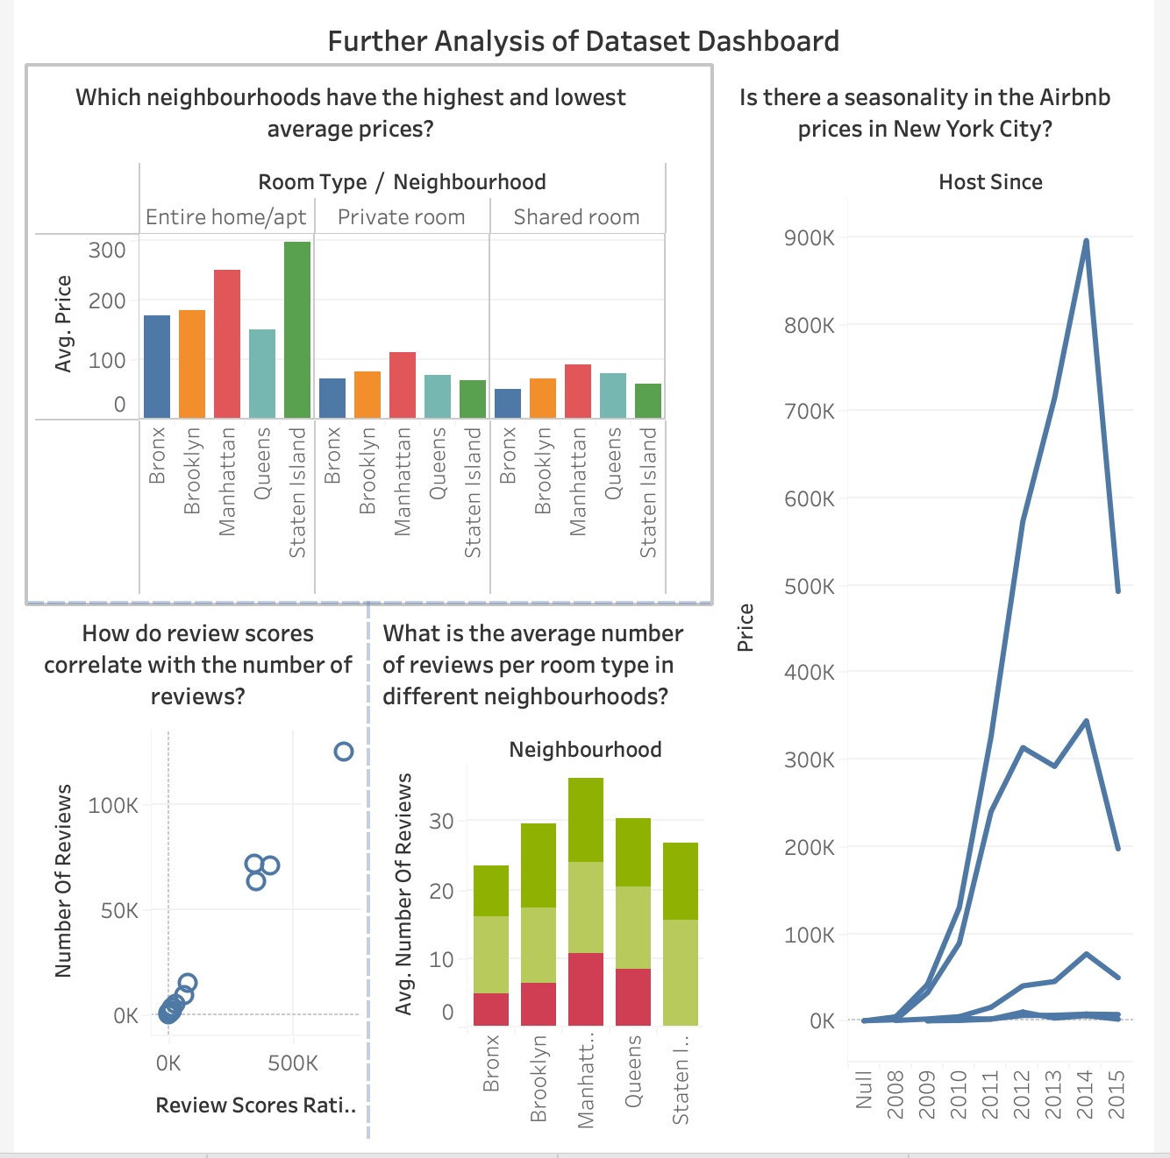

Slide 9
Limitation and observation of analysis
Discrepancies in zip code leading to location error on the map and possibly inaccuracy in the dataset analysis.
Generated geographical coordinates (longitude and latitude) was mislaid in Africa. (Resolution – changed tableau location)
Observation – zip code/location on map displays New Jersey and not New York.

Slide 10
THE END
Thank you for listening

